Slide 1
Final lesson – Wrapping up
14. maj 2018

Slide 2
Agenda
Deploying a web application to Azure
The cloud and how it changes everything

Slide 3

Deploying a web application to Azure

Slide 4
Three approaches
Directly from Visual Studio 2017
The fun and easy prototyping way
Via FTP access
The old and boring
Using deployment chain
We will be using Visual Studio Team Services (VSTS)

Slide 5
This is an all demo session

Slide 6
Visual Studio 2017
Demo time!

Slide 7
FTP
Demo time!

Slide 8
VSTS
Demo time!

Slide 9

The cloud and how it changes everything!

Slide 11
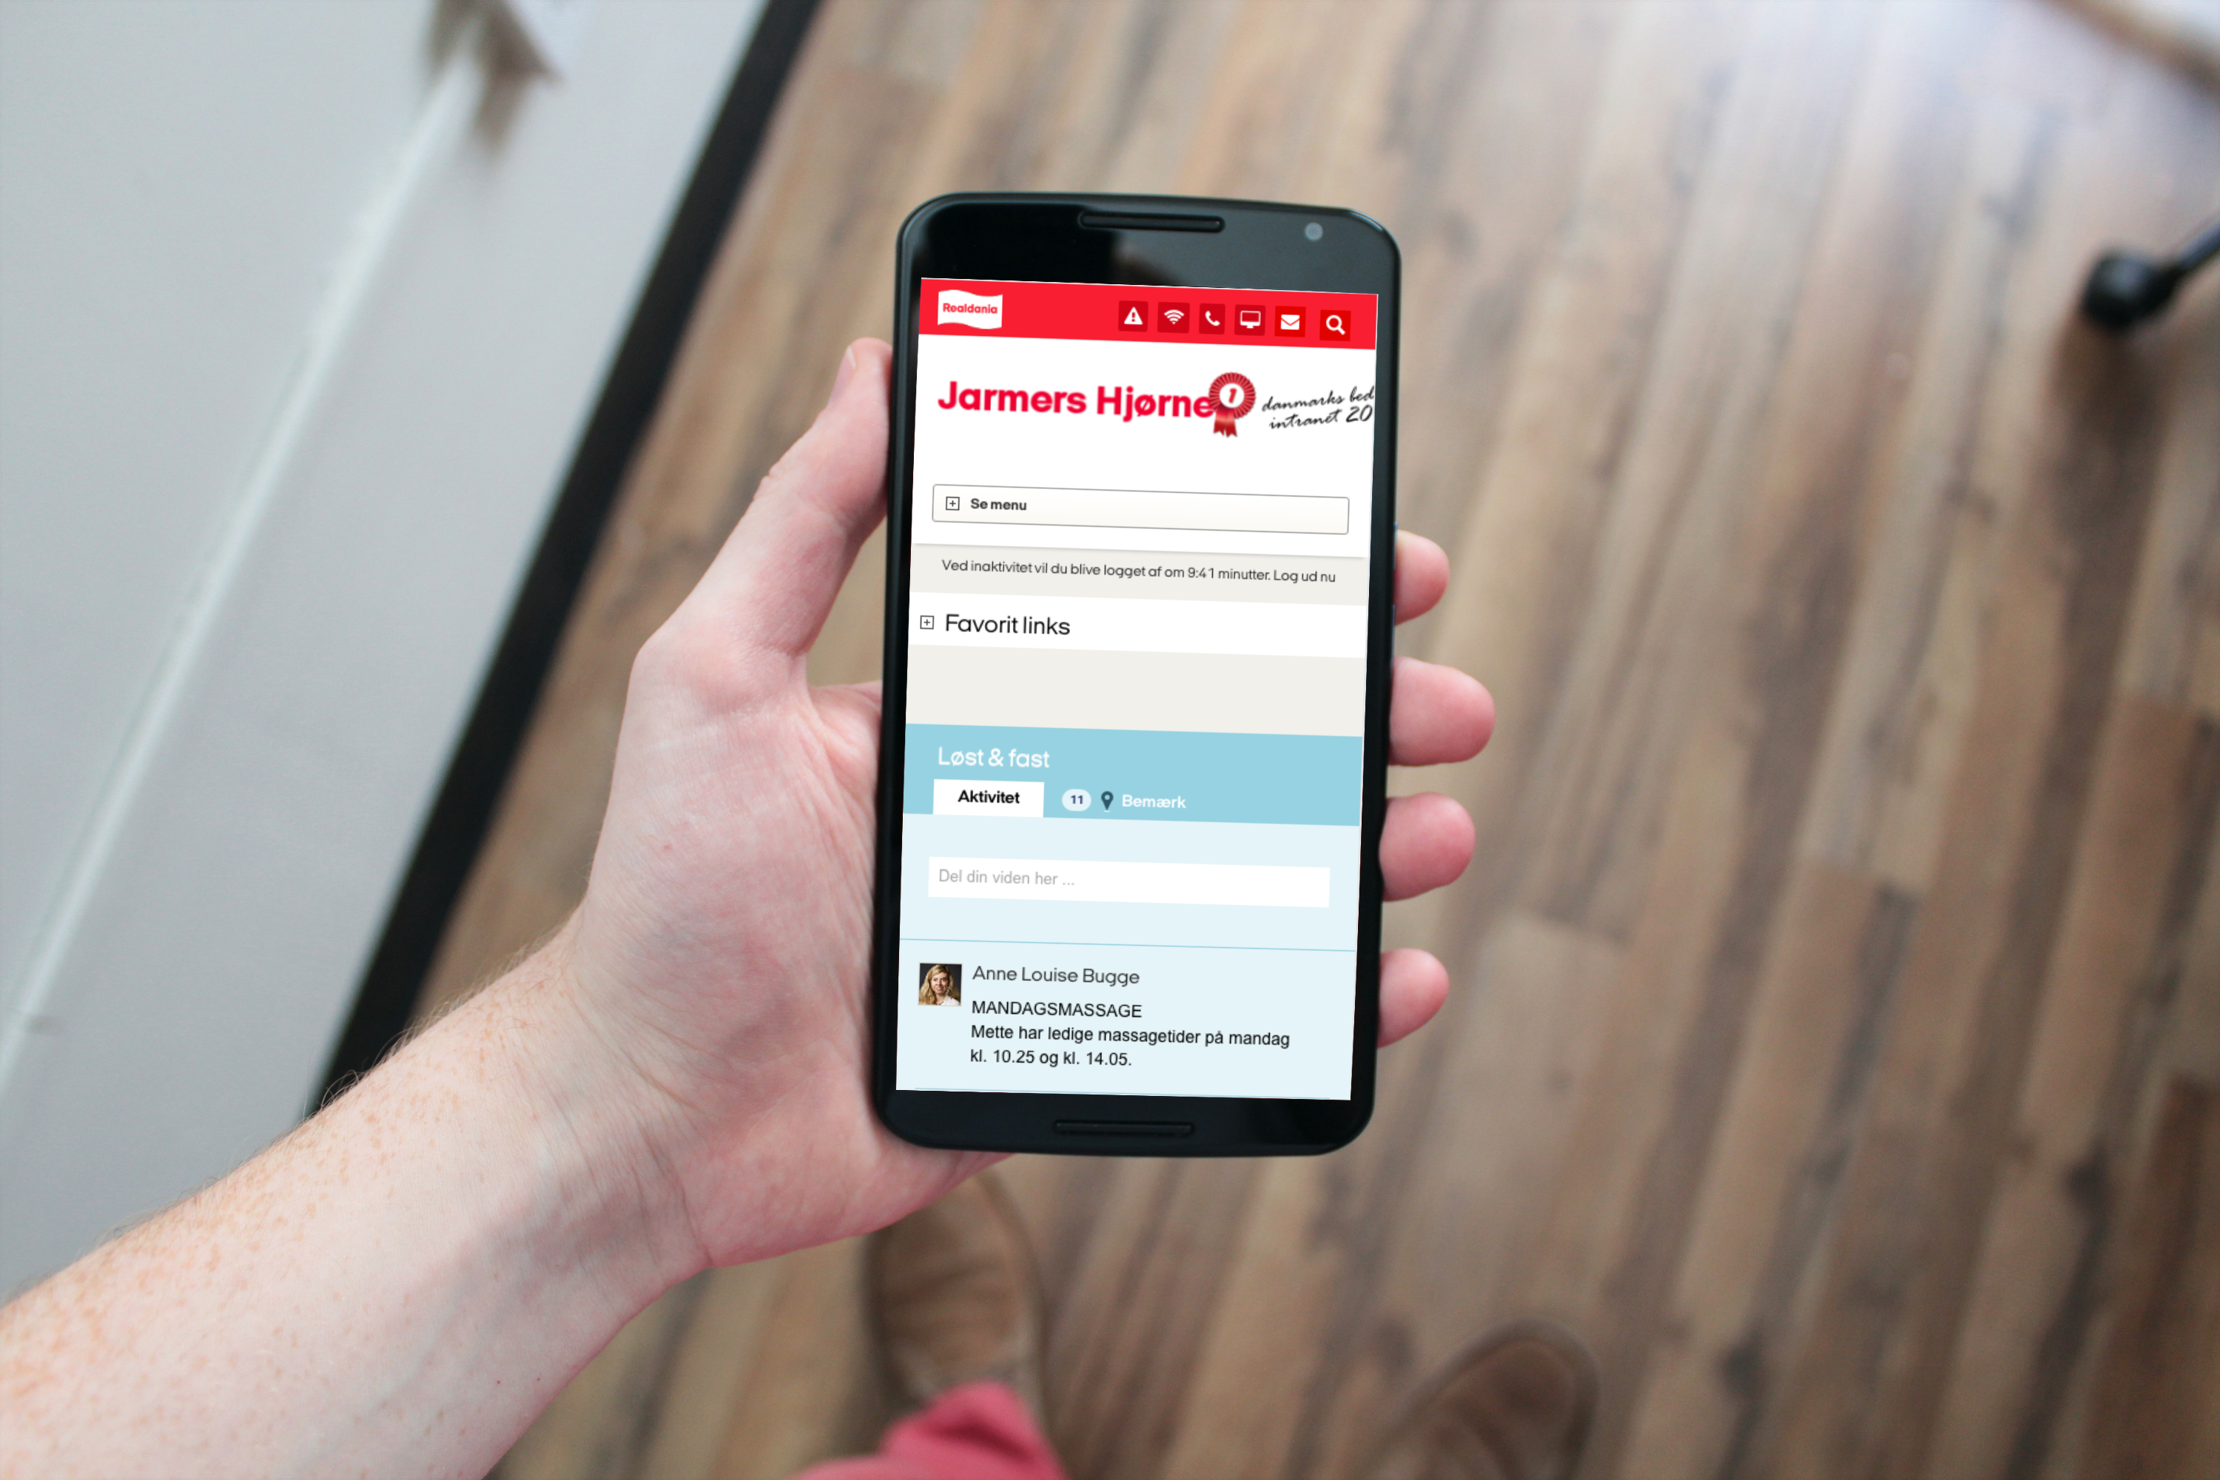
Questions?

Slide 12

Brugbare elementer
Dobbeltklik for at ændre farve eller indsætte baggrundsbillede

